Slide 1
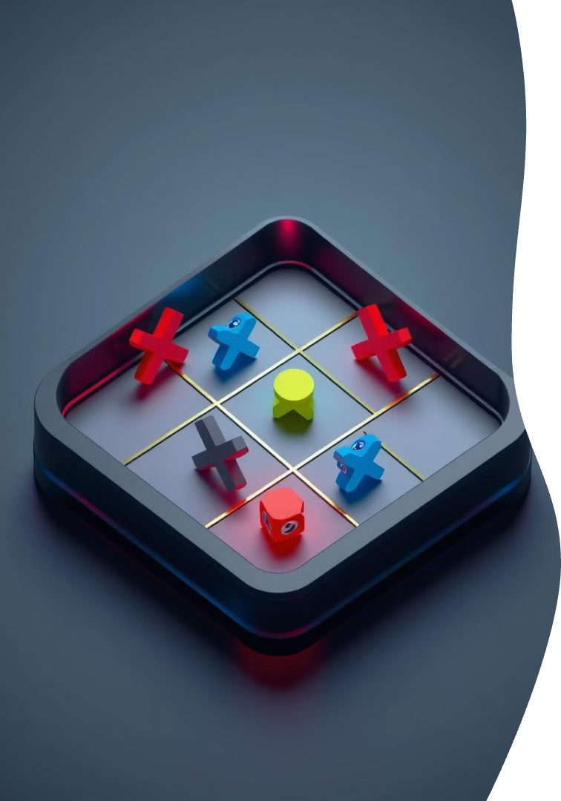
——Tic Tac Toe——

Slide 2
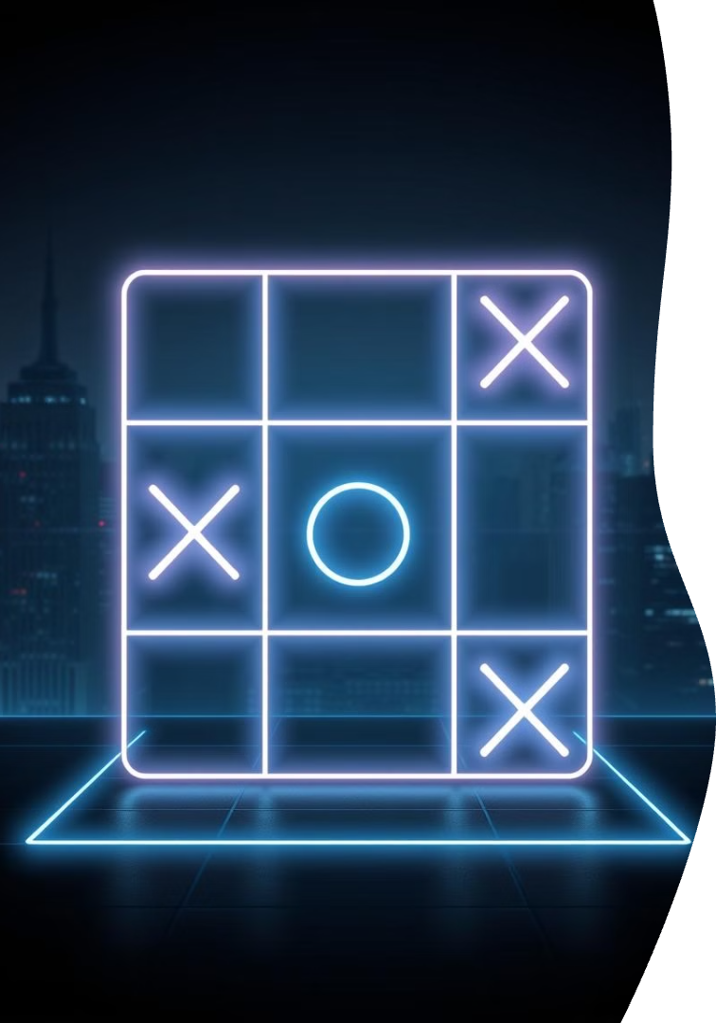
Introduction to Tic Tac Toe
Timeless Strategy
3x3 Grid
Two-player game of strategy and tactics.
Played on a simple 3x3 grid layout.
Create a Line
Achieve three marks in a row to win.
A blend of logic, strategy, and fun for all ages.

Slide 3

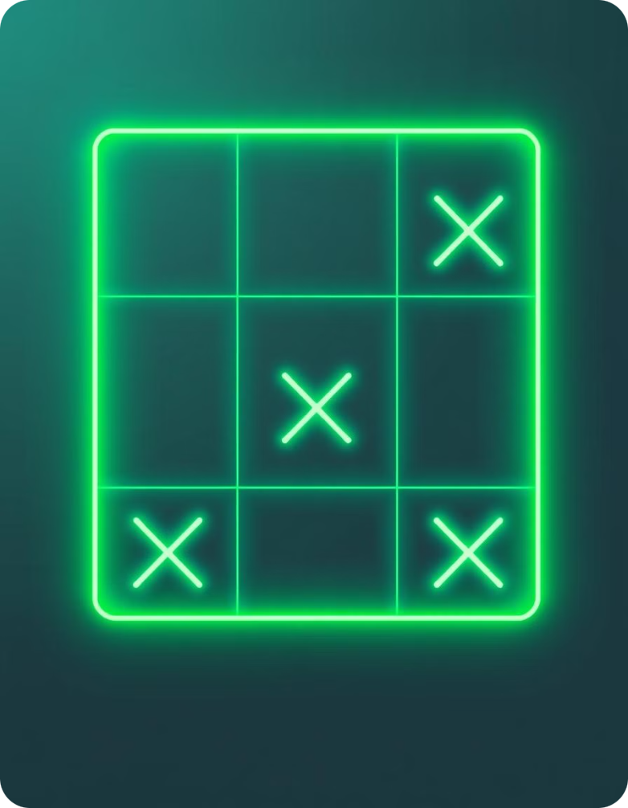



Project Objectives
Functional Game
Build a fully playable Tic Tac Toe game.
User-Friendly
Design an intuitive interface.
Smart Opponent
Implement a challenging computer AI.

Slide 4
Project Methodology
Careful Planning
Smaller Tasks
Thorough Testing
Meticulously planned game logic.
Broke down complex problems.
Rigorous testing of each component.
Developed step-by-step strategy.
Iterative approach to improve the final result.
Ensuring system functionality.

Slide 5
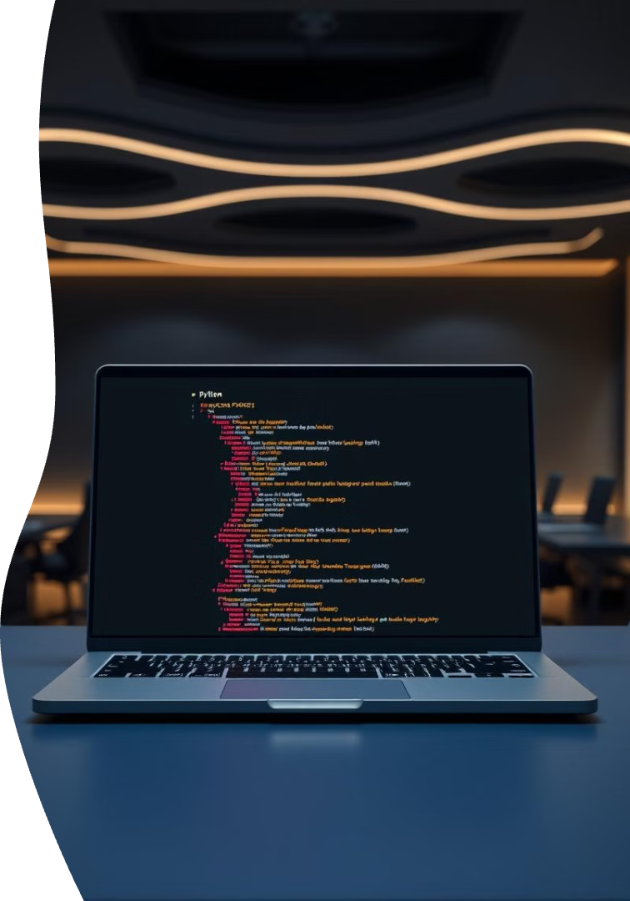



Python: Our Programming Language
Simple Language
Chose Python for its ease of use.
Core Concepts
Used core Python features to build this game.
Readable Code
Implemented with clean, readable code.
Demonstrates Python's versatility in game development.

Slide 6


Technical Highlights
Core Implementation
AI Strategy
Utilized lists for game board representation and implemented key game operations such as move validation using Python.
Developed a basic AI strategy for the computer player, employing algorithms for win-checking and input validation.

Slide 7



Key Takeaways
Game Basics
Learned game development fundamentals.
Logic Skills
Improved programming logic abilities.
Problem Solving
Sharpened problem-solving techniques.

Slide 8
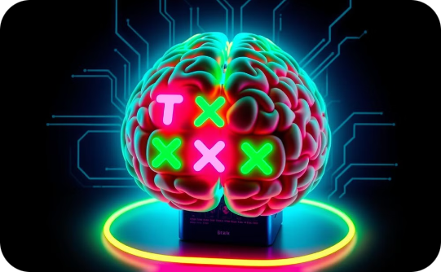
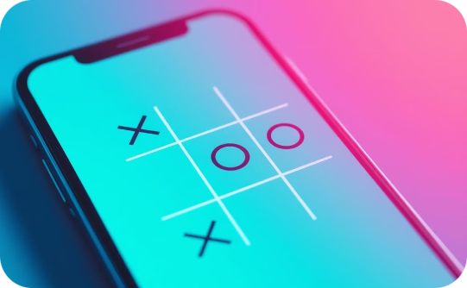
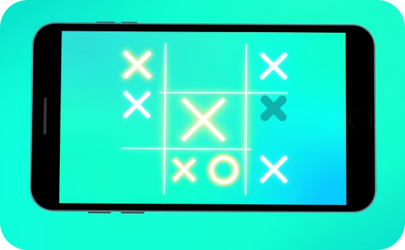
Thank You & Future Development
Improved AI
Enhanced Interface
Multiplayer Mode
Develop a more sophisticated AI opponent for a greater challenge.
Create a visually appealing and intuitive user interface.
Enable players to compete against each other online.
This project showcases core skills and highlights exciting future possibilities for game development.

